Slide 1
Blown To Bits Jigsaw Chapter 3
By: Ian Flanders, Braeden Reyes, Tristian Villanueva, Marc Acidera, Zackry Ulep

Slide 2
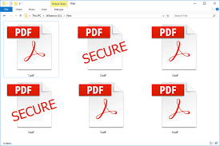
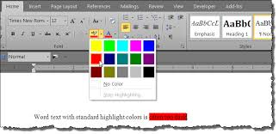
Secrets and Surprises of Electronic Documents(pg 73-79)
Metadata can help one prove or refute a claim
set of data that describes and gives information about other data.
PDF Files include a highlighter tool which are used to highlight the underlying text. The interface shows a yellow highlighter and when clicked on you are able to change the highlighter tool to any color.
Using the highlighter tool is not supposed to be used to hide information.
For example, The newspaper reproduced sections of the CIA report, with black redaction bars to obscure the names of CIA operatives within Iran. This can be removed if you have used the highlighter tool and will reveal any secrets that were not to be seen.

Slide 3
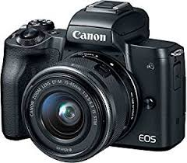
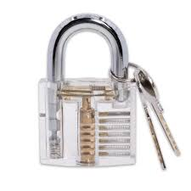
Chapter Three Pages 80-86
Images taken by digital cameras go through the process of you taking the picture and it captures inside the camera something from which an image can be produced.
In a digital camera, the bits in an electronic memory are changed according to a certain pattern and are sort of “ghosts” of the originals.
The internet isn’t secure and it’s not easy to prevent the leakage of sensitive information that is hidden in documents but forgotten by their creator.
Child pornography is illegal, unlike other forms of pornography, because the harm done to the children who are abused to produce it.

Slide 4
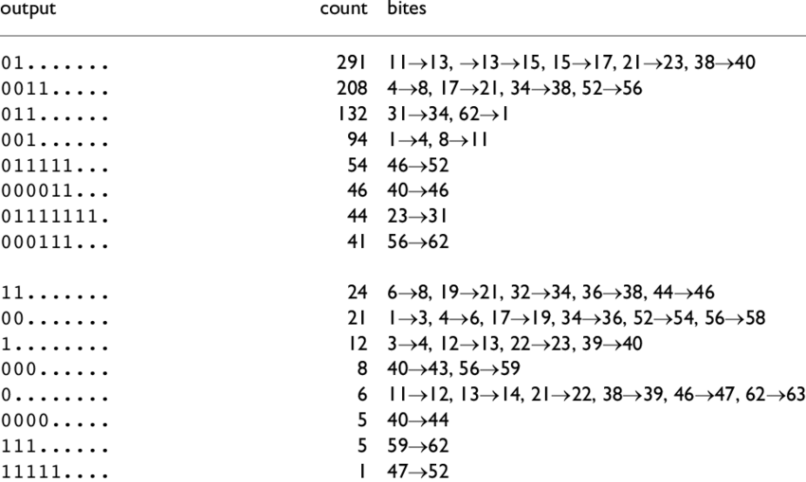
Ghosts in the Machine Page 87-94 Chapter 3
Bit strings represent many things such as numbers, letters and colors etc.
Bit strings can make up audio, video and picture files.
Computers can’t look at bit strings and know what a file is without an extension or program to use it with.
More quality can affect the amount of memory and space the file takes.
Lossy compression is an algorithm that creates shorter data files to save memory and space.

Slide 5
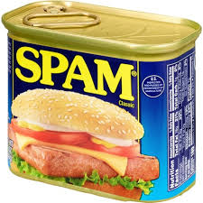

“Hiding Information in Images” Page 95-99 Chapter 3
Most Authors and Human Casualties are unaware of hidden information in text documents.
Anti-Spam software cannot detect or filter certain information due to it being heavily obscure and unclear for the filtering program.
Most spam content that bypass the spam filter involve a known scam like “giving or receiving money” to the victim.
Even though this common it is considered highly illegal and falls under the “Computer Fraud and Abuse act”.

Slide 6
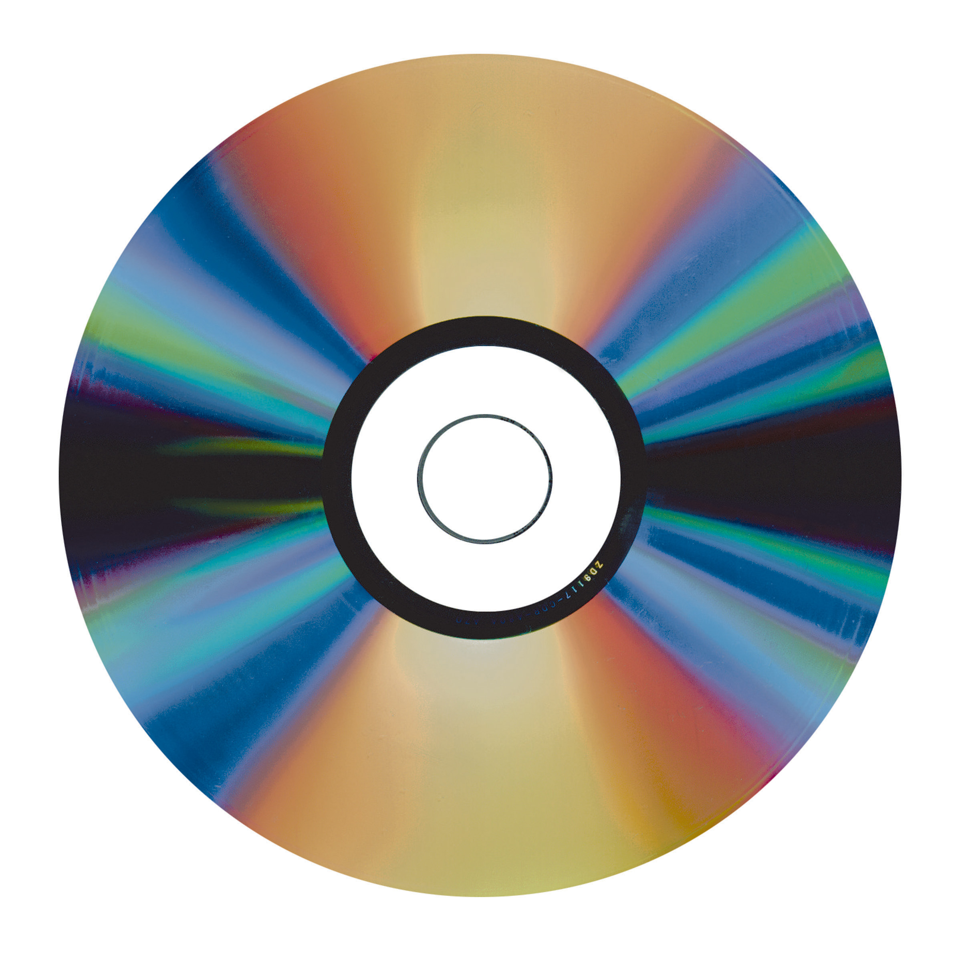



Pages 100-108
Cloud computing became a thing when the process of making disks obsolete
Disks are obsolete because they cannot be played on certain devices because there is no compatibility
Data that is deleted on disks are gone forever
The Federal Trade Commission requires the erasure of customer information so that no information is leaked or read
Computers can now wipe all data
Copies make deleting data harder
People made a type of disk that held information but it was made useless in 15 years and all the data on those disks were lost

